Slide 1
Digital Stopwatch
Often we need stopwatch to differentiate the time of two events, here is a stopwatch design in a simple circuit without using any microcontroller

Slide 2
Components
IC-4026
555 timer ic
Common cathode 7 segment display
Resistors
Capacitor
Push button
Bread board
Connecting wires

Slide 3
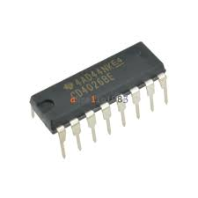
IC CD4026BE
This is counter and seven segment decoding in one package IC which is very to interface with seven segment displays, This IC can be used for decade counting seven segment decimal displays, clocks, watches, timers, counters for meter applications

Slide 4
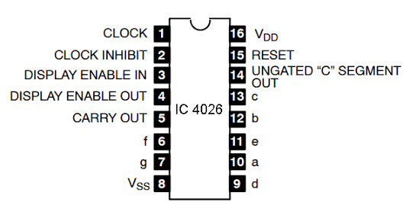
Pin diagram of 4026 is as follows

Slide 5
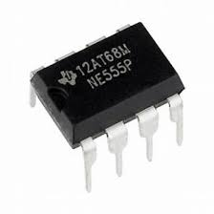
NE555
It’s a highly stable controller capable of producing accurate timing pulses, In A-stable mode the time delay is controlled by two external resistor and capacitor
By formula =time(high+low)=0.693 x (r1+2.r2)c1

Slide 6
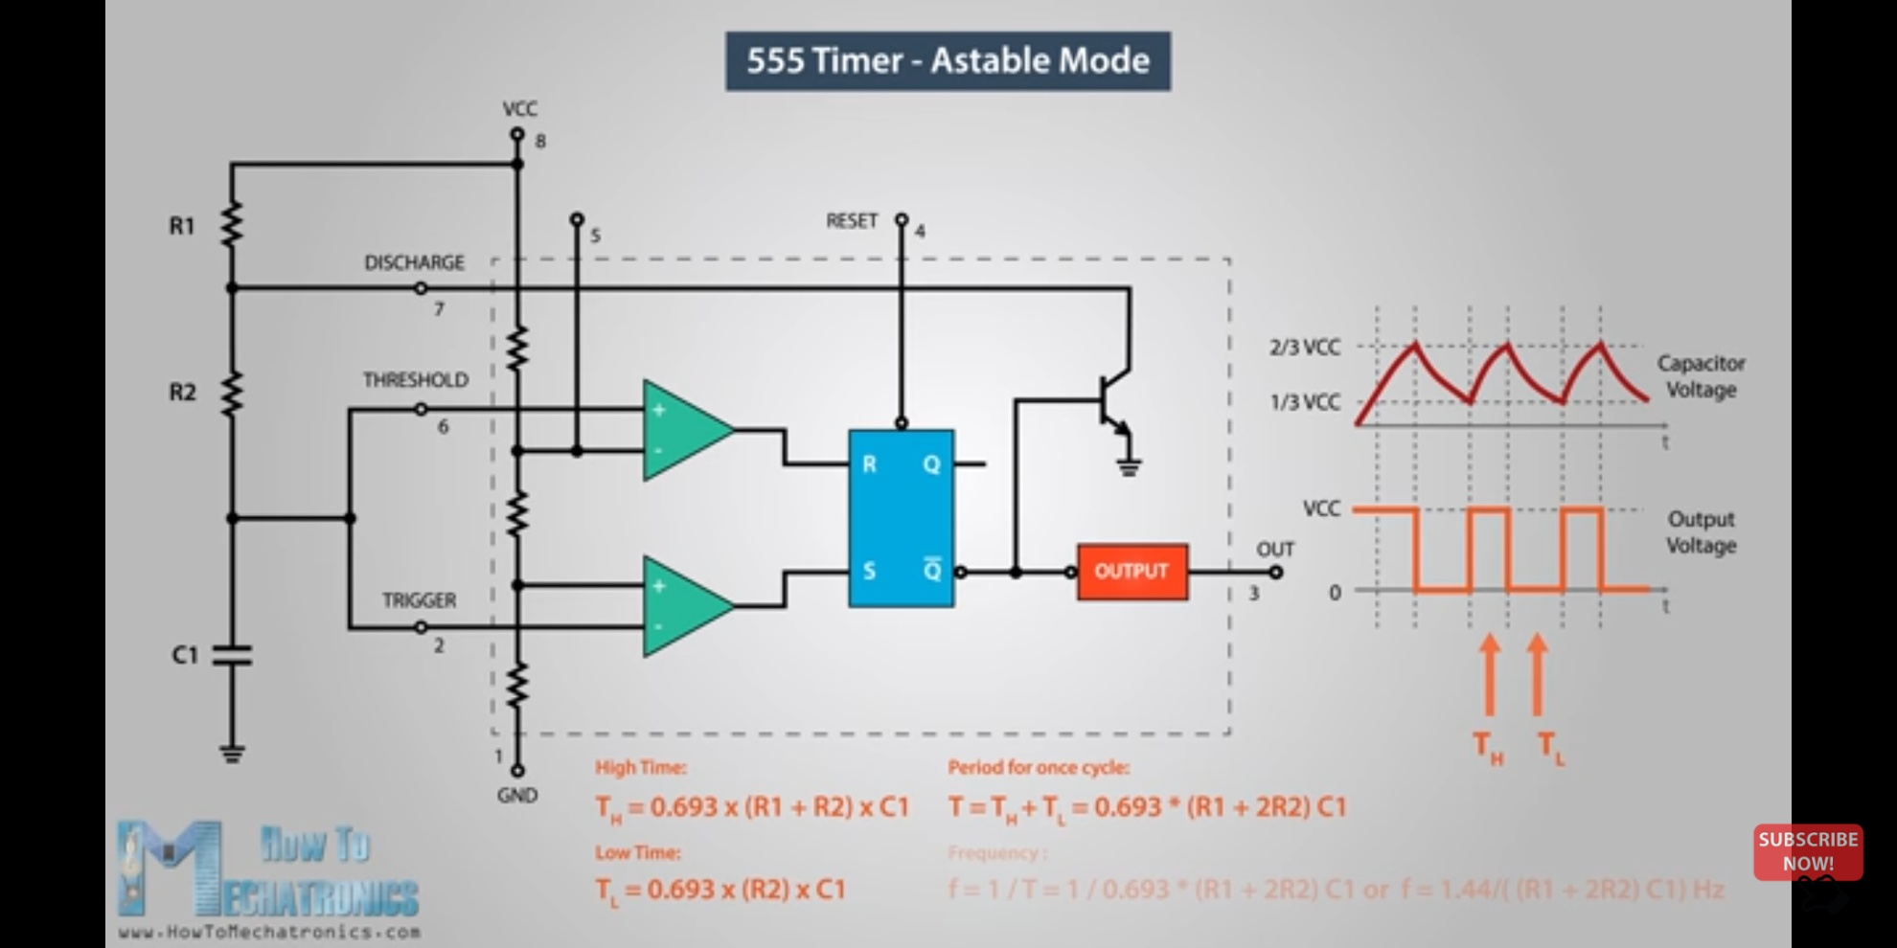
The connection of 555 timer in astable mode is as follows:-

Slide 7
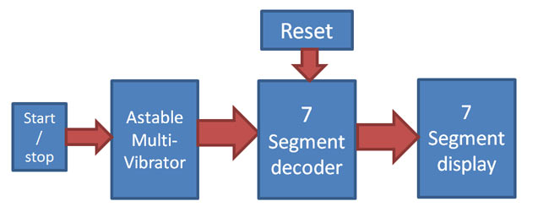
Working

Slide 8
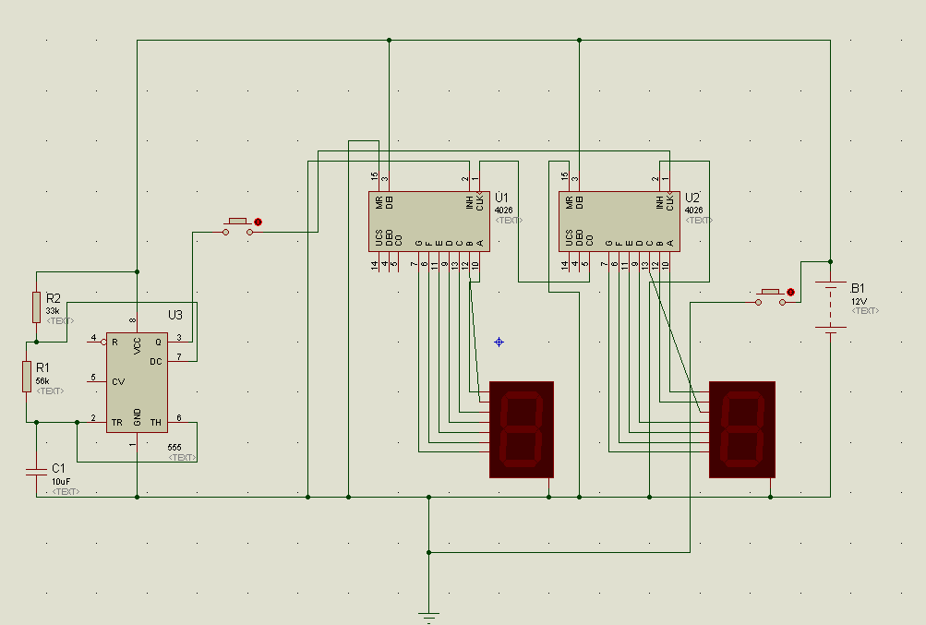
Final layout

Slide 9
Pros
Clear readable output
Accurate and single reading
Not confused reading like analog watches
Can be altered between minutes and miliseconds

Slide 10
cons
Seven segment can be broken easily
Can measure up to only 99 seconds at current setup
Unlike analog the 7 segment uses much higher voltage hence drains much battery

Slide 11
Reference links
https://www.youtube.com/watch?v=WD9slp8YXfk for working of 4026 and 7 segment decoder
https://www.homeandgardenideas.com/web?qo=semQuery&ad=semA&q=working%20of%20555%20timer&o=777288&ag=fw4&an=msn_s&rch=intl445&rtb=29725 for working of 555 timer in astable mode

